Slide 1


How to really use Google NotebookLM update Part 2

Slide 2
What you will learn
What is NotebookLM?
Getting NotebookLM
Understanding Notebooks
Using the Notebook Guide
Creating Audio Overviews / Podcasts
Adding Notes
Asking Questions
Working with Answers
Sharing Notebooks
Use Cases

Slide 3

Using the notebook guide

Slide 4
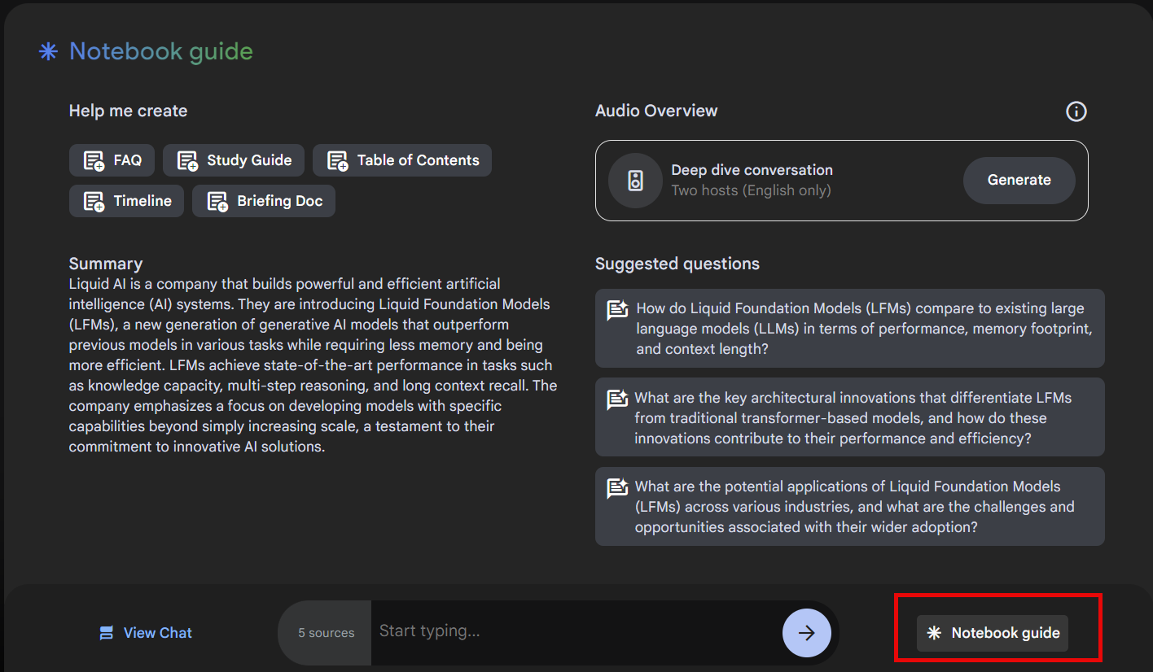
Notebook guide

Slide 5
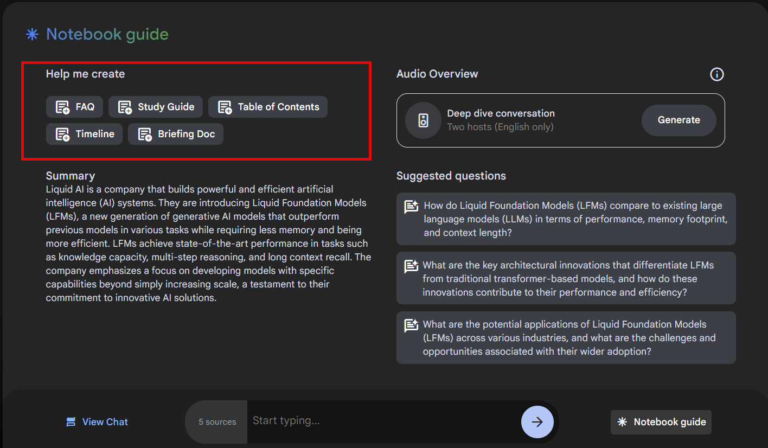
Help me create

Slide 6
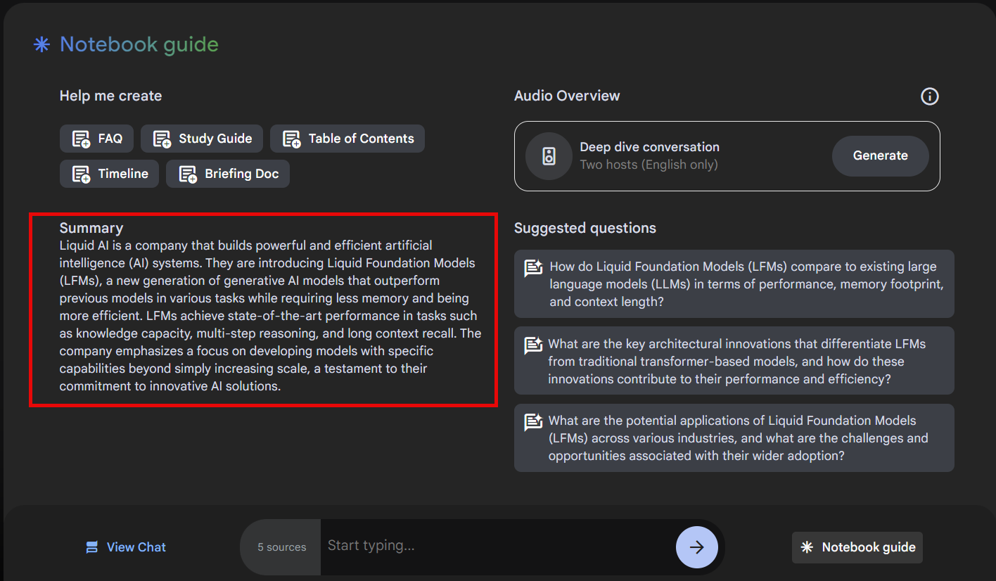
summary

Slide 7
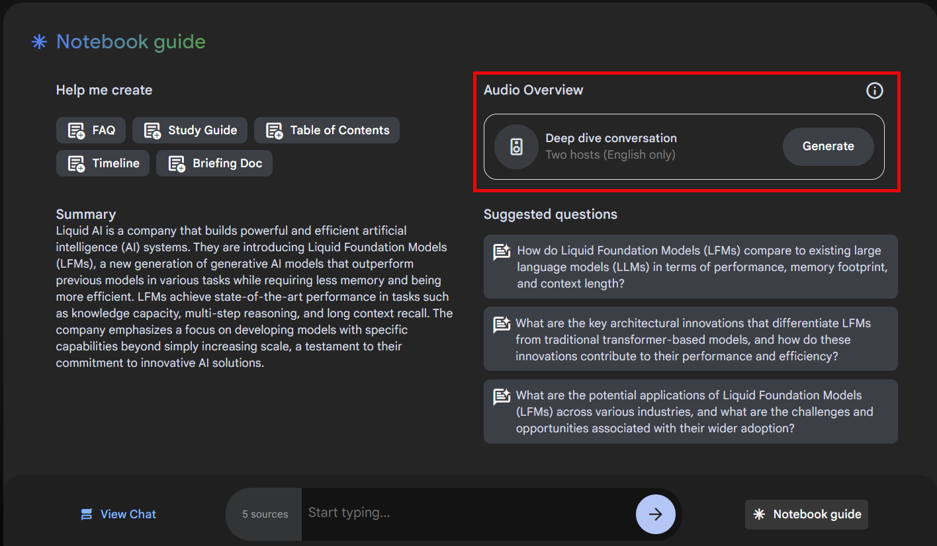
Audio overview / podcast

Slide 8
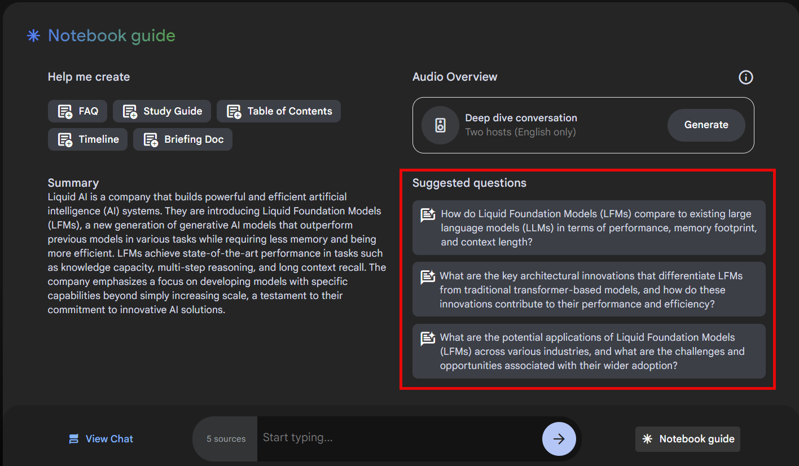
Suggested questions

Slide 9
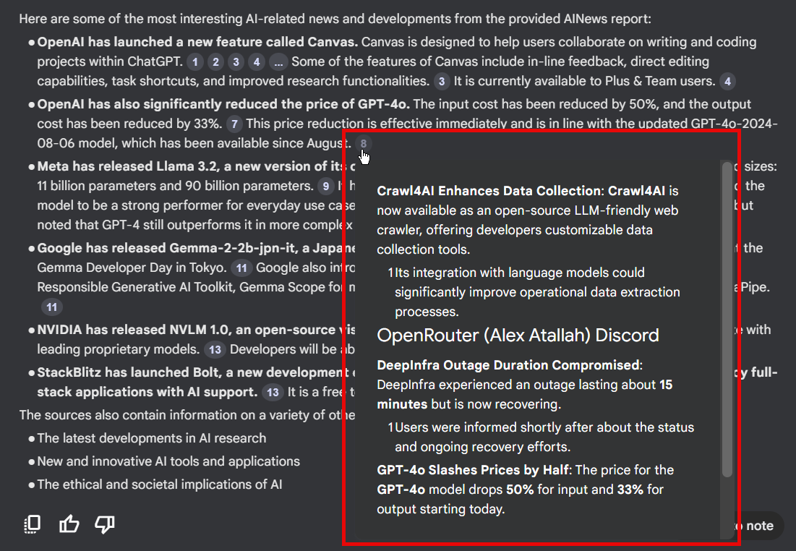
citations

Slide 10
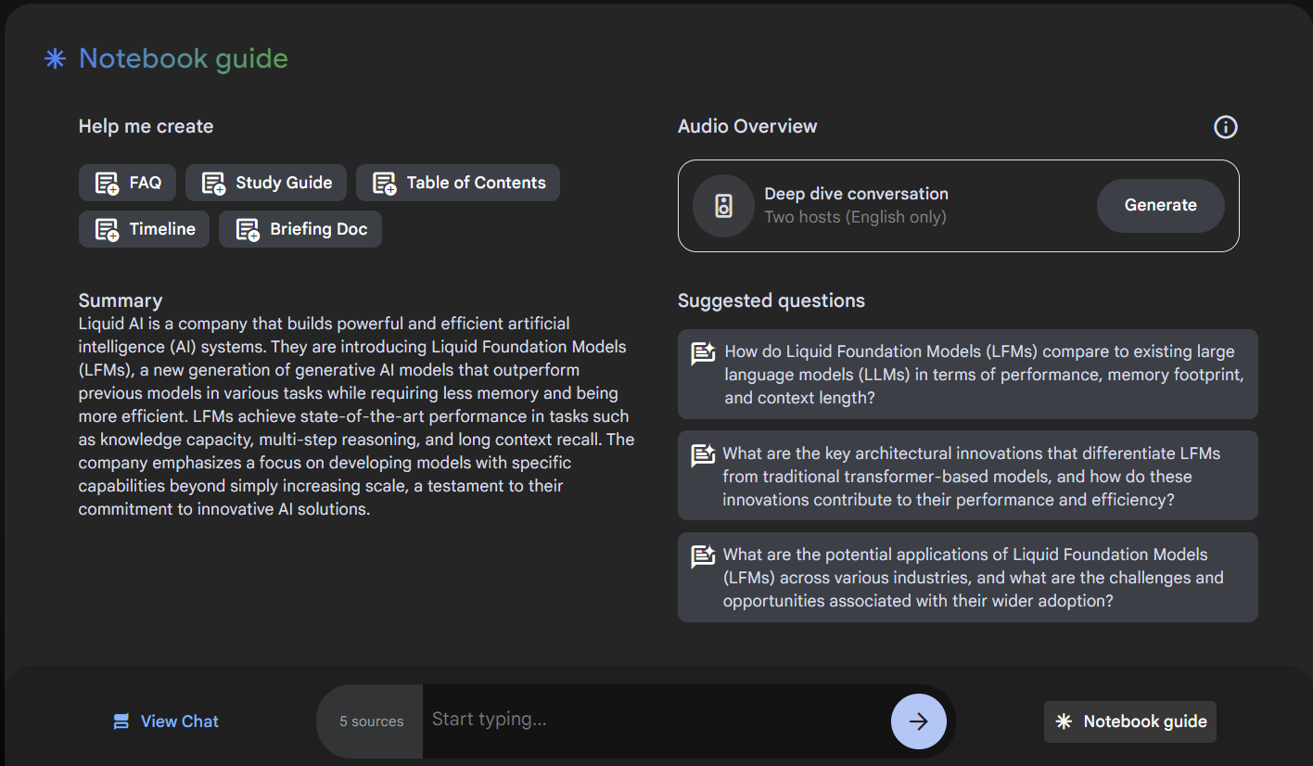
Demo: using notebook guide features

Slide 11

Creating Audio Overviews / podcasts

Slide 12
Audio overview / podcast

Slide 13
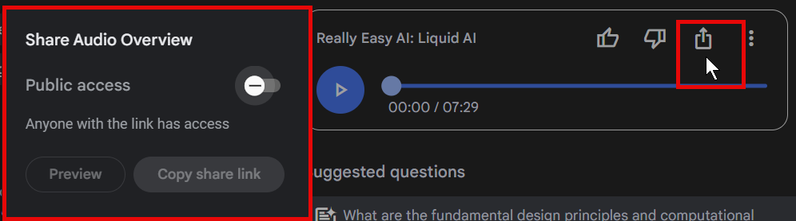
Sharing Audio overview / podcast

Slide 14




Notes:
https://www.youtube.com/channel/UC35ZpwldGw7ZJ5R-2sLijzw

Slide 15

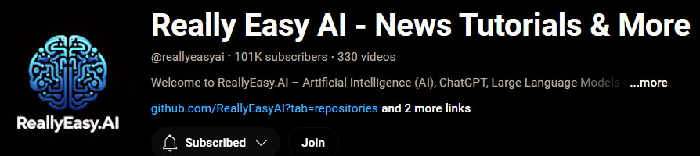
Become a Member!
Notes:
https://www.youtube.com/channel/UC35ZpwldGw7ZJ5R-2sLijzw/join

Slide 16

https://www.youtube.com/@AINewsFresh

Slide 17
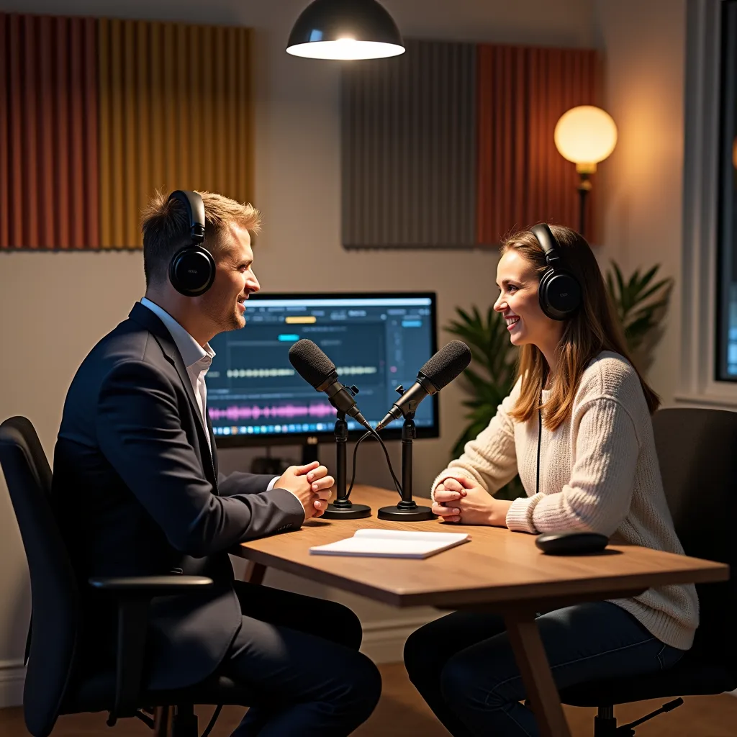
https://www.youtube.com/@DailyAINewsPodcast

Slide 18

Adding Notes

Slide 19
Notes
You can create up to 1,000 notes per notebook
Does not currently support version control and revision history
You can save a useful response to a new note by clicking Save to notes in the upper- right corner of the response. Notes created from saved responses can’t be edited once they are created
You can save passages from your sources into a note
You can choose a variety of suggested action such as “create an outline” when you have one or more existing notes selected

Slide 20
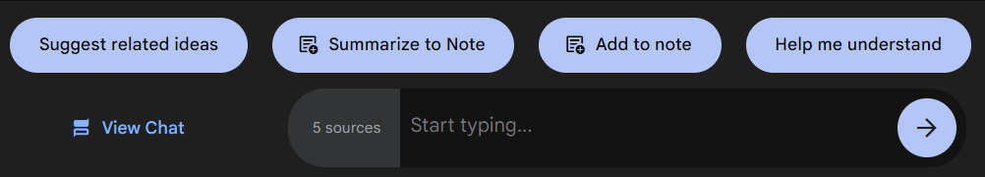
Notes Directly from the Source
You can create notes directly from the source by selecting any passage in the source and using the suggested actions, like “Summarize to note,” in order to preserve the information.

Slide 21
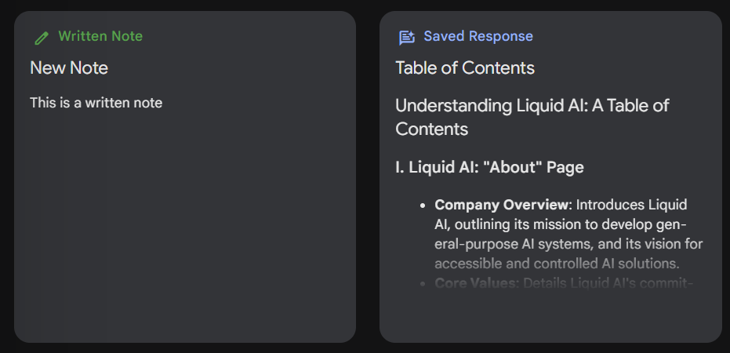
Types of notes
Written Notes that you have composed yourself.
Saved Responses that you have captured, either chat interactions or quotes from your sources

Slide 22
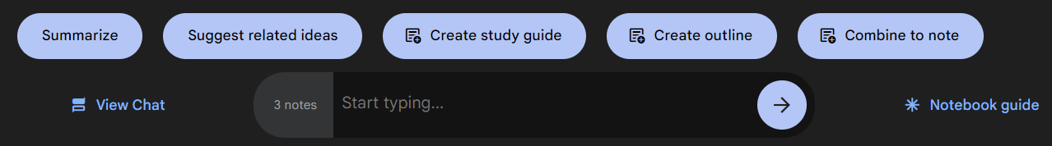
Working with Multiple Notes

Slide 23
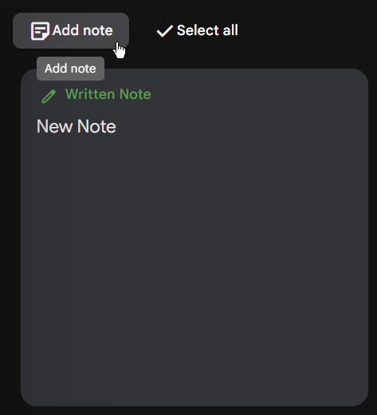
Demo: creating & working with notes

Slide 24


